Slide 1
Design and Analysis of Algorithms
CS602
Lecture 10
Algorithms
for Directed Acyclic Graphs

Slide 2
Recap for the lecture

Slide 3
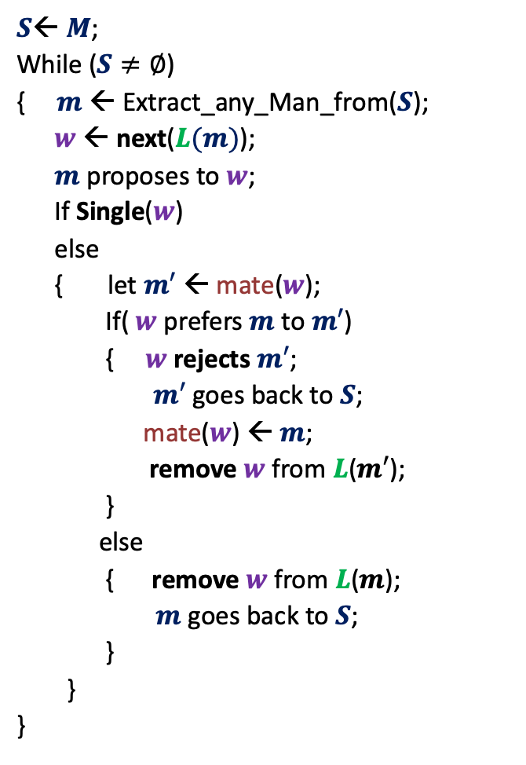




GaleShapley($M$, $W$)
$S$← $M$;
While ($S≠∅$)
{ $m$← Extract_any_Man_from($S$);
$w$ ← next($L(m)$);
$m$ proposes to $w$;
If Single($w$)
else
{ let $m′$ ← mate($w$);
If( $w$ prefers $m$ to $m′$)
{ $w$rejects $m′$;
$m′$ goes back to $S$;
mate($w$) ← $m$;
remove $w$from $L$($m′$);
}
else
{ remove $w$from $L$($m$);
$m$ goes back to $S$;
}
}
}
Question:
What if $|M|<>\left|W\right|$ ?
Answer:
The final matching is still a stable matching.
Proof: ??
mate($w$) ← $m$;
in list $L(w)$, $m$precedes $m′$)
The same ☺

Slide 4


Gale Shapley Algorithm
Theorem:
There cannot exist any other stable matching
that matches a man to a better woman.
Man proposing
Woman pessimal
Man Optimal

Slide 5
Gayle Shapley Algorithm
Man-Proposing version
Proof of Man optimality

Slide 6
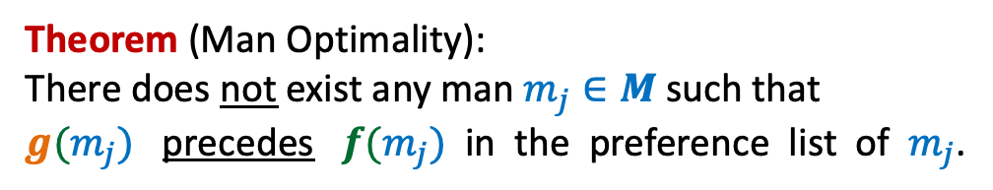

Let $f: M→W$be the matching produced by GS algorithm.
Let $g:M→W$ be any other stable matching.
Theorem (Man Optimality):
There does not exist any man $m_{j}∈M$such that
$g(m_{j})$ precedes $f(m_{j})$ in the preference list of $m_{j}$.
Make sincere attempt to write the proof.
Proof will be discussed sometime in future.

Slide 7
Motivation for the lecture

Slide 8
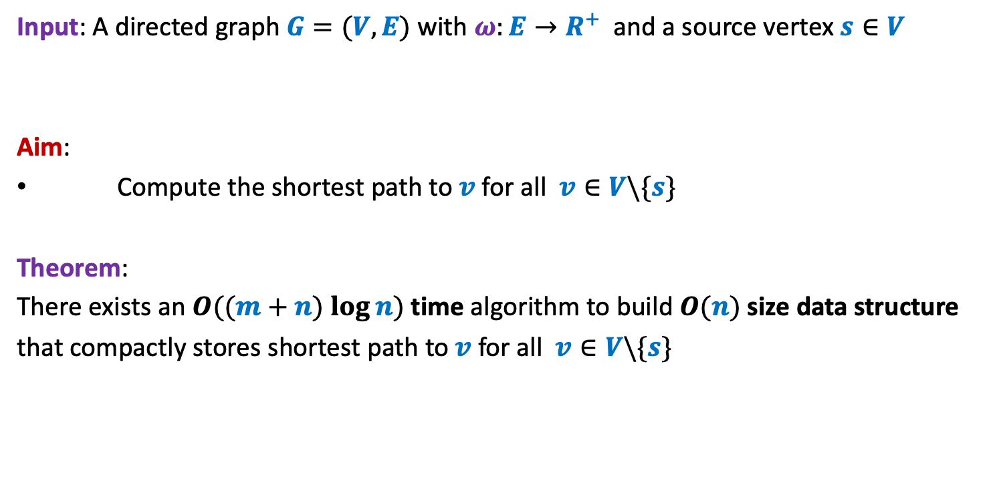
Problem Definition
Input: A directed graph $G=(V,E)$ with $ω:E→R^{+}$ and a source vertex $s∈V$
Aim:
Compute the shortest path to $v$for all $v∈V\backslash \{s\}$
Theorem:
There exists an $O((m+n) log⁡n)$ time algorithm to build $O(n)$ size data structure
that compactly stores shortest path to $v$for all $v∈V\backslash \{s\}$
Longest path to each vertex ?
No polynomial time algorithm till date !

Slide 9
Imagine there were no research in Algorithms. And you are asked to write a program to compute shortest paths from source s to every vertex. Your first attempt would have been to enumerate all paths from source and then report the path which is shortest. But the number of paths from source to any vertex can be exponential. So you would have felt the hardness of the shortest paths problem. May be (if you were like Dijkstra) you would have worked hard and with perseverance and designed the algorithm which we call Dijkstra’s algorithm today.
But consider the situation now when the area of algorithm is quite developed ( very active for more than 50 years). But the best algorithm the researchers have designed till date for the longest paths problem takes exponential time ! What would be your reaction to this reality ?
Frustration, feeling down ? (not good for a person with true scientific spirit)
Curiosity (natural)
There are hundreds of such algorithmic problems in computer science for which the fastest algorithm takes only exponential time.
Towards the end of this course, we shall discuss a theory of such a family of problems.
“Theory of NP complete problems”
With this note, we begin today’s lecture.

Slide 10
Directed Acyclic Graphs

Slide 11






Directed Acyclic Graphs
Question: what is a cycle in $G$?
Answer: A sequence $v_{1}$, $v_{2}$,…, $v_{k}$ such that ($v_{i}$,$v_{i+1}$) $∈E$ for all $1≤i<k$
and ($v_{k}$,$v_{1}$) $∈E$ .
…
$$v_{1}$$
$$v_{2}$$
$$v_{3}$$
$$v_{k−1}$$
$$v_{k}$$

Slide 12
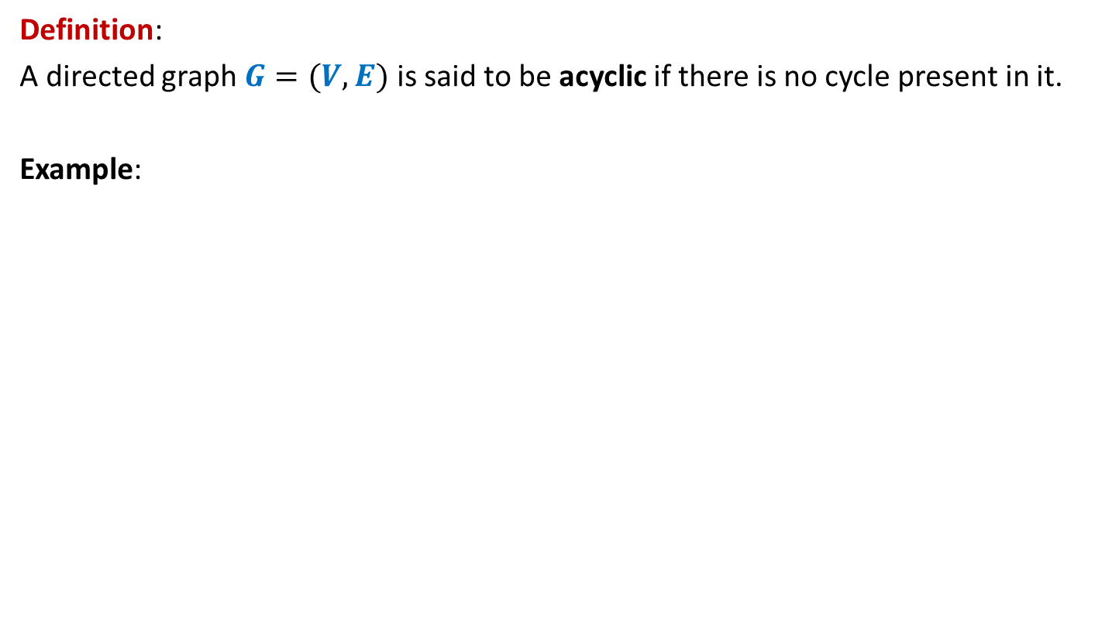
Directed Acyclic Graphs
Definition:
A directed graph $G=(V,E)$ is said to be acyclic if there is no cycle present in it.
Example:
u
DAG
z
b
v
y
x
w
a

Slide 13

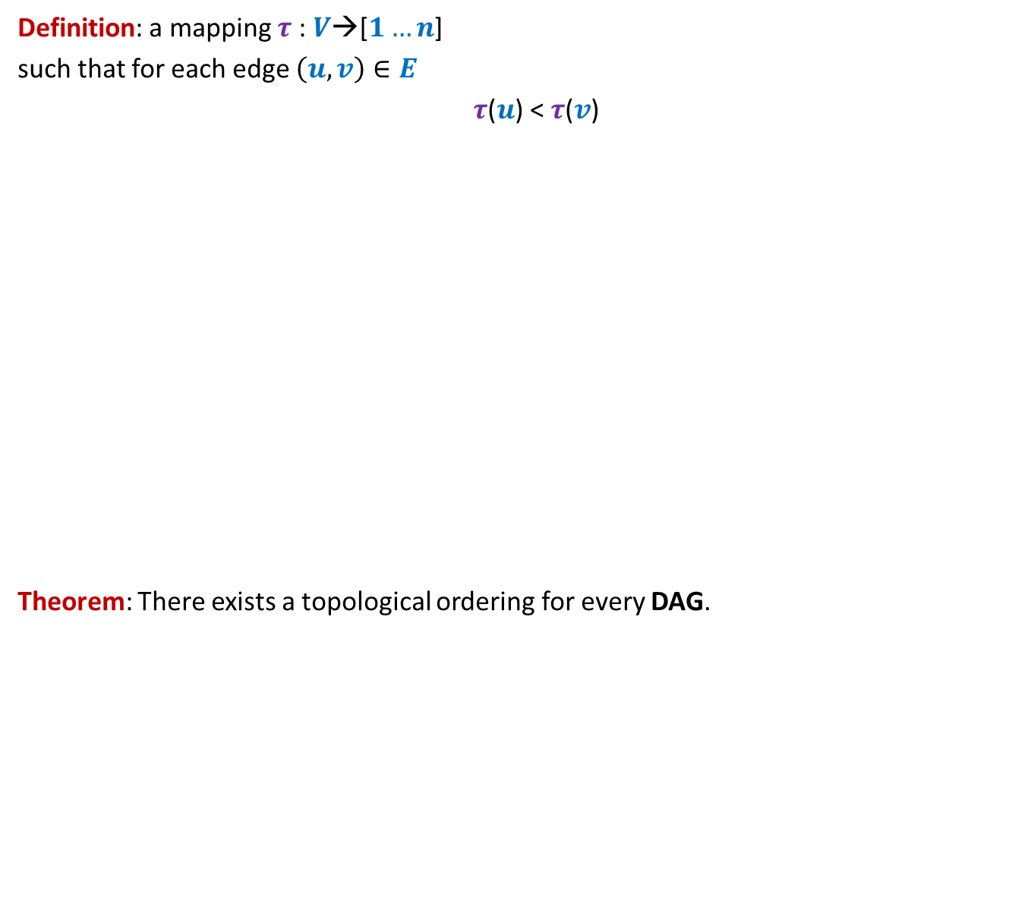
Topological ordering
Definition: a mapping $τ$ : $V$→[$1…n$]
such that for each edge $\left(u,v\right)∈E$
$τ$($u$) < $τ$($v$)
Theorem: There exists a topological ordering for every DAG.
1 2 3 4 5 6 7 8 9 10 11
Does there exist a topological ordering for every directed graph ?
Is it possible to arrange vertices in a line so that each edge goes from left to right ?
>
How to formalize it ?
<
<
<
<
<
<
Certainly No if there is any cycle

Slide 14

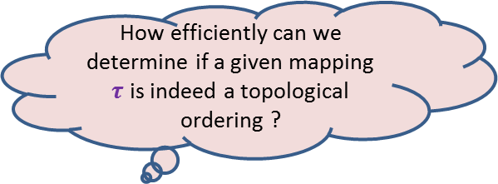
Topological ordering
Example:
This is indeed a valid topological ordering.
u
z
b
v
y
x
w
a
u
v
a
b
x
z
w
y
1 2 3 4 5 6 7 8
How efficiently can we determine if a given mapping $τ$ is indeed a topological ordering ?
O($m+n$) time

Slide 15
Topological ordering
Three questions
Question 1: Why does a topological ordering exist for every DAG ?
Question 2: How efficiently can we compute a topological ordering ?
Question 3: What is the use of topological ordering ?

Slide 16
applications of Topological ordering
Question 3

Slide 17
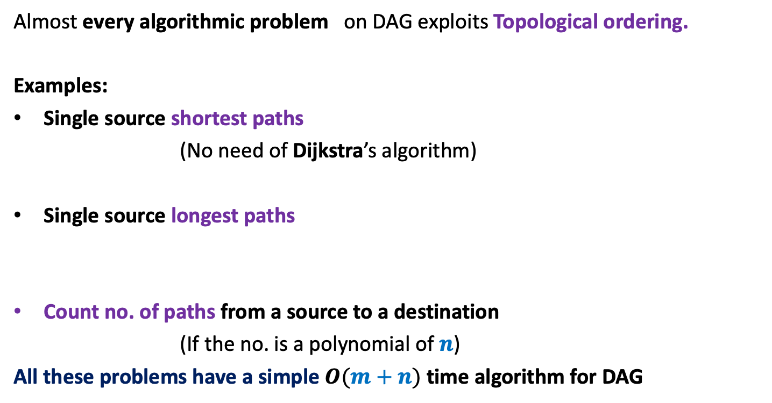
Applications of Topological ordering
Almost every algorithmic problem on DAG exploits Topological ordering.
Examples:
Single source shortest paths
(No need of Dijkstra’s algorithm)
Single source longest paths
Count no. of paths from a source to a destination
(If the no. is a polynomial of $n$)
All these problems have a simple $O(m+n)$ time algorithm for DAG

Slide 18
Why Does Topological ordering exist for every DAG?
Question 1

Slide 19
Why does Topological ordering exist ?
Example:
u
z
b
v
y
x
w
a
What is the guarantee that such a vertex always exists in a DAG ?
Any vertex of indegree=0 can be given number 1 in a topological ordering.
Is there any vertex for which you can be sure of its place in the ordering?

Slide 20

Why does Topological ordering exist ?
Lemma 1: Every DAG has at least one vertex with in-degree = 0.
Proof:
(an algorithmic proof)
Pick any vertex $v$.
While in-degree$(v)$ $≠$ 0 do
{ Let $(u,v)$ be an edge
$v$← $u$;
}
return $v$;
Observation: This algorithm, if terminates will output a vertex of indegree =0.
But what is the guarantee that it will terminate.?
The algorithm does indeed terminate.
In fact, no vertex will be processed twice in while loop.
…
c
b
y
x
c
a
cycle

Slide 21
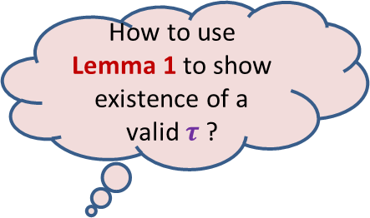
Why does Topological ordering exist ?
Lemma 1: Every DAG has at least one vertex with in-degree = 0.
u
z
b
v
y
x
w
a
How to use Lemma 1 to show existence of a valid $τ$ ?

Slide 22
Why does Topological ordering exist ?
u
z
b
v
y
x
w
a
u
v
a
b
x
z
w
y
1
2
3
4
5
6
7
8

Slide 23

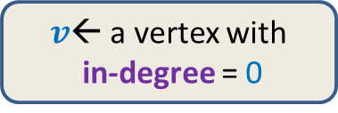
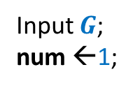
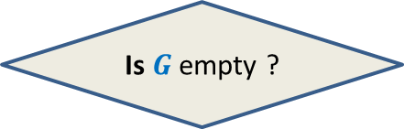


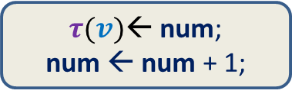

Why does Topological ordering exist ?
$O(m)$ time
Time complexity of the algorithm: ?
$O(mn)$
Input $G$;
num ←1;
$v$← a vertex with
in-degree = 0
$τ(v)$← num;
num ← num + 1;
Remove $v$ and all its outgoing edges;
Yes
NO
Is $G$ empty ?
A valid $τ$

Slide 24
How efficiently can we compute Topological ordering ?

Slide 25
Important Questions
Aim:
To design a more efficient implementation of the algorithm.
Question:
What is the most time consuming step of the algorithm ?
Answer: Searching a vertex of in-degree = 0 ?
Question:
Do we need to compute from scratch the next vertex of in-degree 0 every time ?
Answer: Perhaps not !
Let us explore closely the algorithm to see
“how and when the vertices with in-degree=0 get created” ?

Slide 26
Revisiting the example
..but slowly this time…
The new vertices with indegree=0 are created during ?
u
z
b
v
y
x
w
a
u
v
a
b
x
z
w
y
1
2
3
4
5
6
7
8
the processing of the current vertex of indegree=0

Slide 27
How to efficiently maintain
the set of vertices with in-degree=0?
Queue

Slide 28

Algorithm for Topological ordering
Topological-ordering($G$)
{ Create-queue($Q$);
For each $x∈V$ {
if (in-degree[$x$] = 0)
En-queue($x$,$Q$) }
num ← 1;
While( ? )
$v$← De-queue($Q$);
$τ$($v$) ← num;
num ← num + 1;
For each ($v,x$) $∈E$ do
in-degree[$x$] ← in-degree[$x$] – 1;
if (in-degree[$x$] = 0) En-queue($x$,$Q$);
not-empty($Q$)
{
O($deg(v)$) time
{
?
}
} return $τ$ ;
How to show that time complexity is $O(m+n)$?

Slide 29
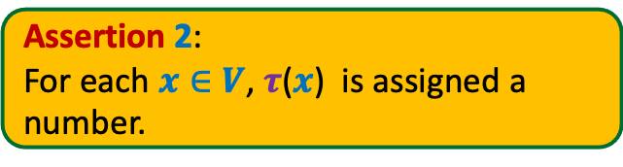
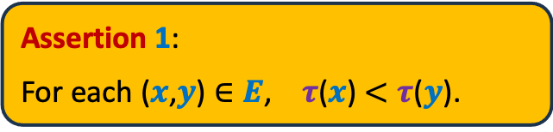
Algorithm for Topological ordering
Topological-ordering($G$)
{ Create-queue($Q$);
For each $x∈V$ {
if (in-degree[$x$] = 0)
En-queue($x$,$Q$) }
num ← 1;
While( ? )
$v$← De-queue($Q$);
$τ$($v$) ← num;
num ← num + 1;
For each ($v,x$) $∈E$ do
in-degree[$x$] ← in-degree[$x$] – 1;
if (in-degree[$x$] = 0) En-queue($x$,$Q$);
Assertion 1:
For each ($x$,$y$) $∈E$, $τ$($x$) $<τ$($y$).
Assertion 2:
For each $x∈V$, $τ$($x$) is assigned a
number.
not-empty($Q$)
{
{
What is the proof of correctness ?
}
} return $τ$ ;
Make sincere attempt to come up with the proof.
Proof will be discussed sometime in future.

Slide 30
Applications of topological ordering ?

Slide 31
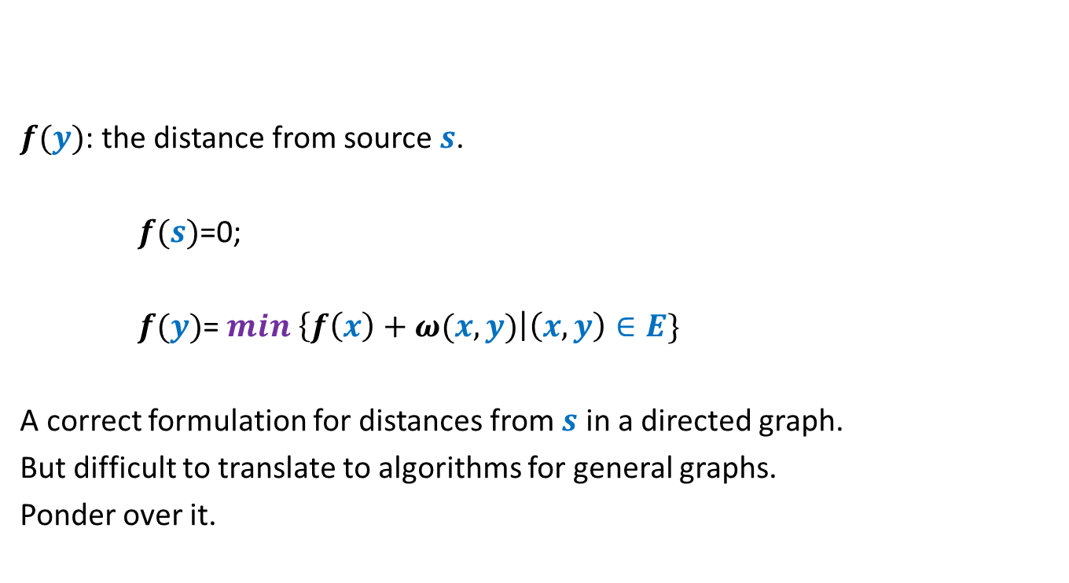
Example: Single source shortest paths
But, this formulation leads to a very simple and efficient algorithm for distance in DAGs.
$f(y)$: the distance from source $s$.
$f(s)$=0;
$f(y)$= $min$ $\left\{f\left(x\right)+ω(x,y)\right|\left(x,y\right)∈E\}$
A correct formulation for distances from $s$ in a directed graph.
But difficult to translate to algorithms for general graphs.
Ponder over it.
Now ponder over it.☺

Slide 32

Topological ordering
A mapping $τ$ : $V$→[$1…n$] such that
For each edge $\left(u,v\right)∈E$ , $τ$($u$) < $τ$($v$)
1 2 3 4 5 6 7 8 9 10 11

Slide 33



Applications of Topological ordering I
A mapping $τ$ : $V$→[$1…n$] such that
For each edge $\left(u,v\right)∈E$ , $τ$($u$) < $τ$($v$)
Let $f$ be a function on $V$that we wish to compute
If $f(y)$ can be expressed in terms of ONLY $\left\{f\left(x\right) \right|\left(x,y\right)∈E\}$
It is useful to compute $f$ in this order
1 2 3 4 5 6 7 8 9 10 11
$$y$$

Slide 34
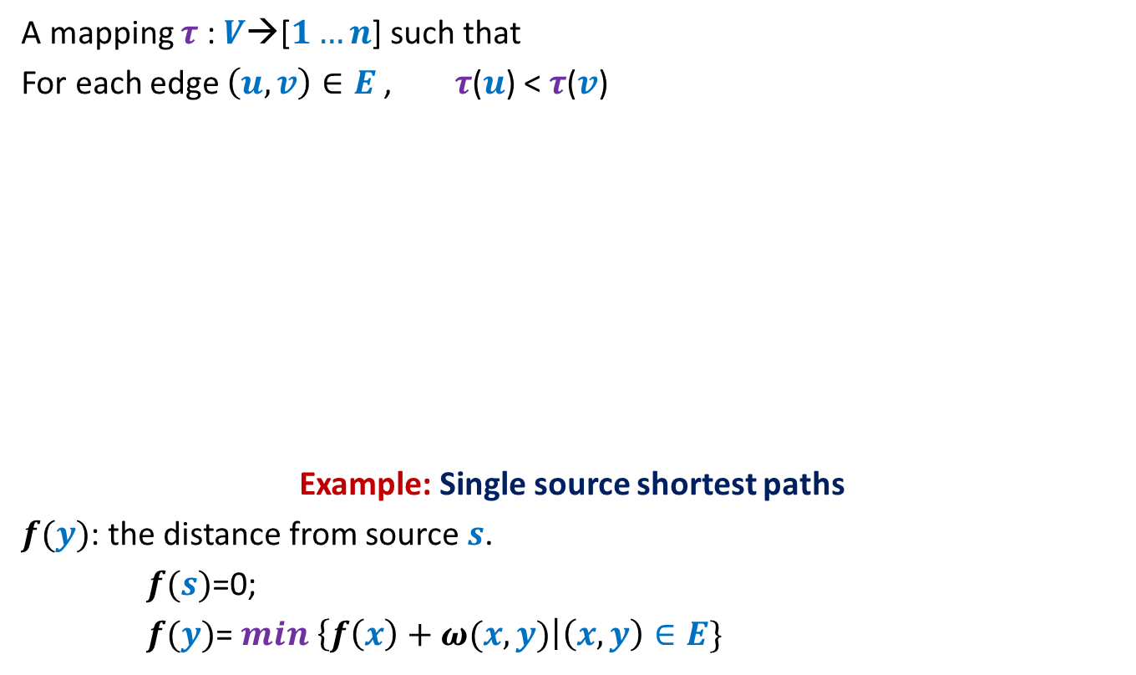

Applications of Topological ordering I
A mapping $τ$ : $V$→[$1…n$] such that
For each edge $\left(u,v\right)∈E$ , $τ$($u$) < $τ$($v$)
Example: Single source shortest paths
$f(y)$: the distance from source $s$.
$f(s)$=0;
$f(y)$= $min$ $\left\{f\left(x\right)+ω(x,y)\right|\left(x,y\right)∈E\}$
It is useful to compute $f$ in this order
1 2 3 4 5 6 7 8 9 10 11
$$y$$
$O(m+n)$ time algo

Slide 35


Applications of Topological ordering II
A mapping $τ$ : $V$→[$1…n$] such that
For each edge $\left(u,v\right)∈E$ , $τ$($u$) < $τ$($v$)
Let $f$ be a function on $V$that we wish to compute
If $f(y)$ can be expressed in terms of ONLY $\left\{f\left(z\right) \right|\left(y,z\right)∈E\}$
➔We can compute $f$ by processing vertices in decreasing order of $τ$.
It is useful to compute $f$ in this order
1 2 3 4 5 6 7 8 9 10 11
$$y$$

Slide 36
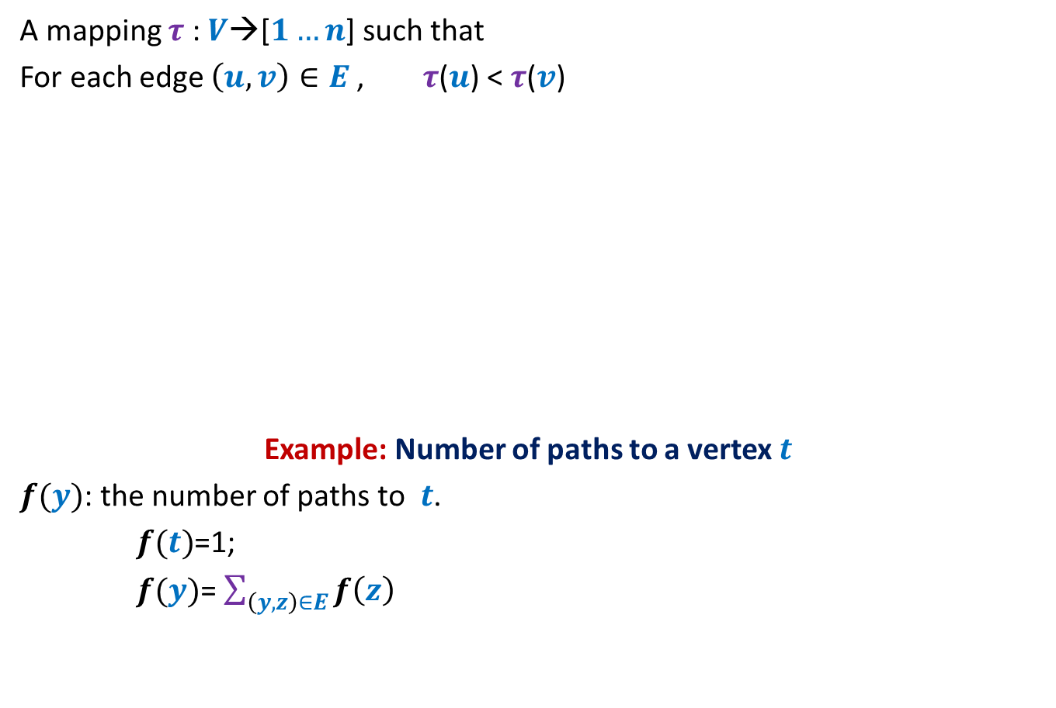
Applications of Topological ordering II
A mapping $τ$ : $V$→[$1…n$] such that
For each edge $\left(u,v\right)∈E$ , $τ$($u$) < $τ$($v$)
Example: Number of paths to a vertex $t$
$f(y)$: the number of paths to $t$.
$f(t)$=1;
$f(y)$= $\sum_{\left(y,z\right)∈E}{f\left(z\right)}$
It is useful to compute $f$ in this order
1 2 3 4 5 6 7 8 9 10 11
$$y$$
$O(m+n)$ time algo

Slide 37
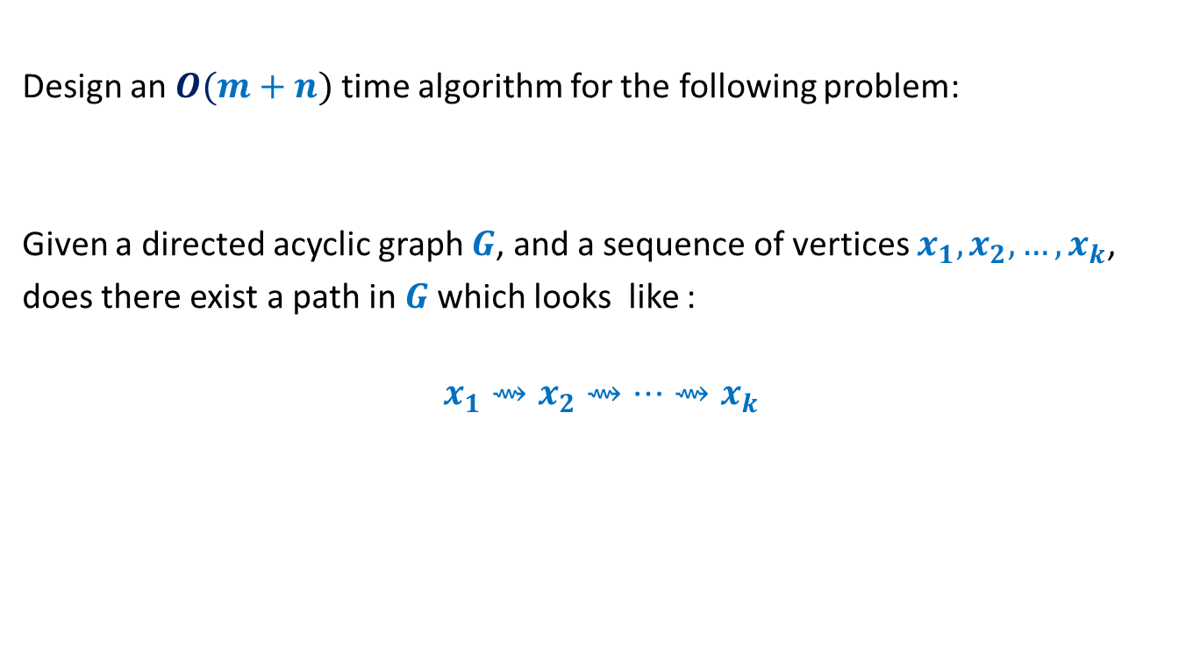
Homework
Design an $O(m+n)$ time algorithm for the following problem:
Given a directed acyclic graph $G$, and a sequence of vertices $x_{1},x_{2},…,x_{k}$,
does there exist a path in $G$which looks like :
$$x_{1}⇝x_{2}⇝…{⇝x}_{k}$$

Slide 38
Moral of the story
Think of a problem on DAG
Think of topological ordering
☺

